Slide 1
Accuracy Metrics

Slide 2
What is confusion matrix?
A Confusion matrix is an N x N matrix used for evaluating the performance of a classification model, where N is the number of target classes.
The matrix compares the actual target values with those predicted by the machine learning model.
Confusion matrices are used to visualize important predictive analytics like recall,, accuracy, and precision.
Confusion matrices are useful because they give direct comparisons of values like True Positives, False Positives, True Negatives and False Negatives.

Slide 3
Explain in brief about True positive, True Negative, False Positive, False negative.
True Positive (TP)
The predicted value matches the actual value
The actual value was positive and the model predicted a positive value
True Negative (TN)
The predicted value matches the actual value
The actual value was negative and the model predicted a negative value

Slide 4
False Positive (FP) – Type 1 error
The predicted value was falsely predicted
The actual value was negative but the model predicted a positive value
Also known as the Type 1 error
False Negative (FN) – Type 2 error
The predicted value was falsely predicted
The actual value was positive but the model predicted a negative value
Also known as the Type 2 error

Slide 5
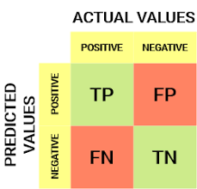

Slide 6
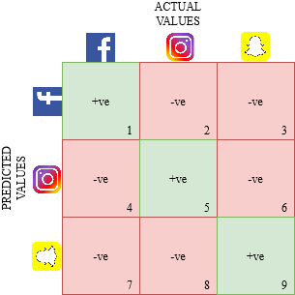
example

Slide 7
What is type 1 error and type 2 error?
Type I error is equivalent to a False positive.
Type II error is equivalent to a False negative.
Example:
Construction Model of a bridge is correct.
Type I error: Predicting that the model is correct when it is not.
Type II error: Predicting that a model is not correct when it is correct.

Slide 8
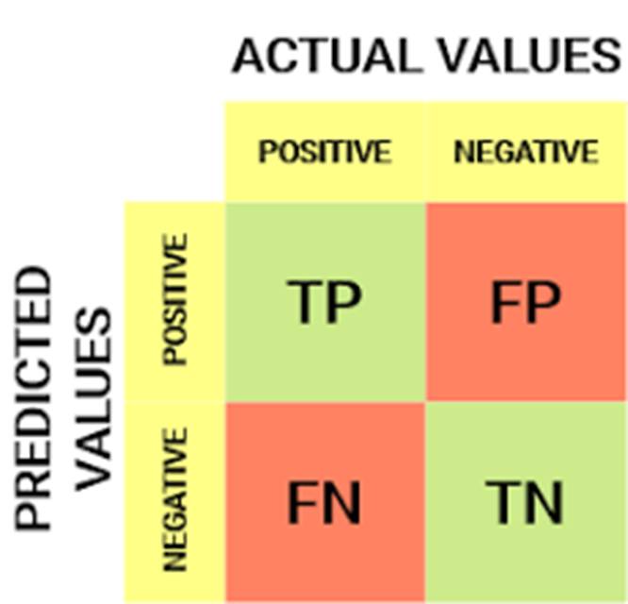

Define Precision.(Positive predictive value ppv)
PRECISION:
Precision tells us how many of the correctly predicted cases actually turned out to be positive.
Precision = TP/Predicted yes
High precision gives high accuracy

Slide 9


DEFINE RECALL(sensitivity,hit rate,true positivr rate(tpr))
Recall tells us how many of the actual positive cases we were able to predict correctly with our model.
Recall = TP/Actual Yes
High recall value gives high accuracy

Slide 10

Define Accuracy AND Define Accuracy.
Accuracy = (TP+TN)/Total
Error rate = (1 – accuracy)
Or
Error rate = (FP+FN)/ Total

Slide 11

Define F1 score
In practice, when we try to increase the precision of our model, the recall goes down, and vice-versa. The F1-score captures both the trends in a single value
F1-score is a harmonic mean of Precision and Recall, and so it gives a combined idea about these two metrics. It is maximum when Precision is equal to Recall.
Closer the F1 Score to 1. Better the accuracy.

Slide 12
THANK YOU

